Slide 1

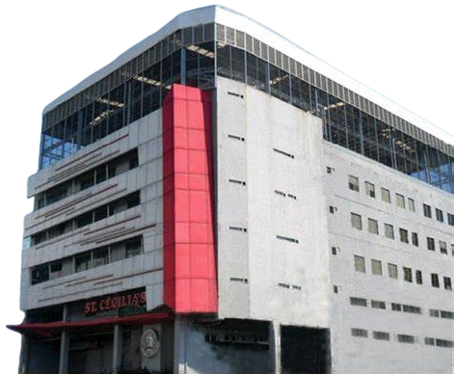


iSmart Cecilia LMS
Introduction
Literatures
Methodology
System Design
Evaluating & Testing
iSmart
Cecilia LMS
Team Loki

Slide 2
Cecilian Portal
Introduction
Literatures
Methodology
System Design
Evaluating & Testing
RATIONALE
Library Management System (LMS) is designed to automate and enhance the overall library process in institutions. It improves efficiency by using technologies such as RFID for cataloging, circulation, user identification, and theft detection. According to studies, RFID-based LMS enables faster book transactions—issuing, returning, and renewing—without manual input, as RFID tags store unique book information that can be read directly by RFID readers instead of barcodes.

Slide 3
Cecilian Portal
Introduction
Literatures
Methodology
System Design
Evaluating & Testing
RATIONALE
In the Philippine context, institutional libraries still face issues like misplaced resources, losses, and inefficiencies due to manual operations (Alvarez & Dela Cruz, 2020). To address this, the proposed project introduces an RFID and QR-Based Library Management System for St. Cecilia’s College – Cebu, Inc., integrating automated inventory, security, checkout, and return processes. The inclusion of QR codes further enhances convenience and accuracy in tracking and managing book inventories.

Slide 4
Cecilian Portal
Introduction
Literatures
Methodology
System Design
Evaluating & Testing
SUPPORT LITERATURE
Dorado (2019) explored how Filipino librarians in academic and public libraries view and adapt to technological innovations like RFID and QR code systems. The study found that most librarians have a positive attitude toward adopting new technologies and are willing to learn tools that improve efficiency and user experience. However, the rate of adoption differs among institutions due to disparities in resources, training, and infrastructure. The research also highlighted a digital divide, showing that while librarians are open to innovation, limited funding and technological support hinder full implementation of modern, technology-based library management systems in the Philippines.

Slide 5
Cecilian Portal
Introduction
Literatures
Methodology
System Design
Evaluating & Testing
SUPPORT LITERATURE
Reyes and Villanueva (2021) examined the use of RFID technology in Philippine university libraries and found that it significantly improves operational efficiency. The study reported that RFID reduces the time needed for book check-in and check-out, minimizes manual errors, and enhances tracking accuracy. It also concluded that RFID systems create a more organized and user-friendly library environment, allowing librarians to focus more on information services rather than manual cataloguing. Overall, the research emphasized that RFID adoption supports digital transformation in libraries and aligns with the broader modernization efforts of educational institutions.

Slide 6
Cecilian Portal
Introduction
Literatures
Methodology
System Design
Evaluating & Testing
SIGNIFICANCE OF THE STUDY
  Students
  Librarian
  Library Staff
  Researchers
  Future Researchers

Slide 7
Cecilian Portal
Introduction
Literatures
Methodology
System Design
Evaluating & Testing
OBJECTIVES

Slide 8
Cecilian Portal
Introduction
Literatures
Methodology
System Design
Evaluating & Testing
GENERAL OBJECTIVE
To design, develop, and implement an RFID and QR-Code Integrated Library Management System for St. Cecilia’s College – Cebu, Inc. that automates book borrowing and returning, streamlines inventory management, and enhances security and user experience within the library.

Slide 9
Cecilian Portal
Introduction
Literatures
Methodology
System Design
Evaluating & Testing
SPECIFIC OBJECTIVE
To determine the feasibility of implementing an integrated RFID and QR-Code system in the St. Cecilia’s College library by evaluating its potential benefits, challenges, and overall impact on library operations.
To develop functional and technical specifications of the system based on the requirements, workflows, and roles identified through consultation with library staff and other stakeholders.

Slide 10
Cecilian Portal
Introduction
Literatures
Methodology
System Design
Evaluating & Testing
SPECIFIC OBJECTIVE
To design and develop an RFID-based access module that allows students to use their RFID cards as entry passes to the library and as digital credentials for borrowing and returning books.
To integrate a QR-Code-based inventory feature that enables staff to track, identify, and update book records efficiently through QR scanning, thereby reducing manual errors and time spent on cataloguing.
To evaluate the system’s effectiveness in improving transaction speed, inventory accuracy, and user satisfaction compared to the existing manual library process, and to establish maintenance guidelines for sustainable system operation.

Slide 11
Cecilian Portal
Introduction
Framework
Methodology
System Design
Evaluating & Testing
SCOPE AND LIMITATION

Slide 12
Cecilian Portal
Introduction
Literatures
Methodology
System Design
Evaluating & Testing
SCOPE
  The iCecilia Smart Library Management System is developed to automate the daily library operations of Saint Cecilia’s College through the integration of QR code and RFID technology. The primary scope of this study focuses on the implementation of a digital library management platform that manages book inventories, tracks student transactions, and monitors library attendance in a more efficient and systematic manner.

Slide 13
Cecilian Portal
Introduction
Literatures
Methodology
System Design
Evaluating & Testing
SCOPE
  Through QR integration, each book in the inventory is assigned a unique QR code, which stores its essential information such as the title, author, publisher, and category. This enables the staff to process borrowing and returning transactions by simply scanning the QR code of the book. Meanwhile, RFID integration allows the system to identify and record each student’s attendance in the library by using their assigned RFID card or FID code. This ensures accurate monitoring of time-in and time-out records for every student visiting the library.

Slide 14
Cecilian Portal
Introduction
Literatures
Methodology
System Design
Evaluating & Testing
LIMITATION
  The system’s functionalities are limited to the internal library operations of Saint Cecilia’s College and are not intended for large-scale or multi-campus deployment. The application runs on a local server environment (XAMPP), meaning that access is restricted to computers within the same local network.

Slide 15
Cecilian Portal
Introduction
Literatures
Methodology
System Design
Evaluating & Testing
TOOLS & TECHNOLOGIES
  Python
  XAMPP (for Database)
  HTML, CSS, JavaScript
  Jinja2 Templating Engine

Slide 16
Cecilian Portal
Introduction
Literatures
Methodology
System Design
Evaluating & Testing
SYSTEM USERS / ACTORS
  Student
  Library Staff
  Librarian

Slide 17
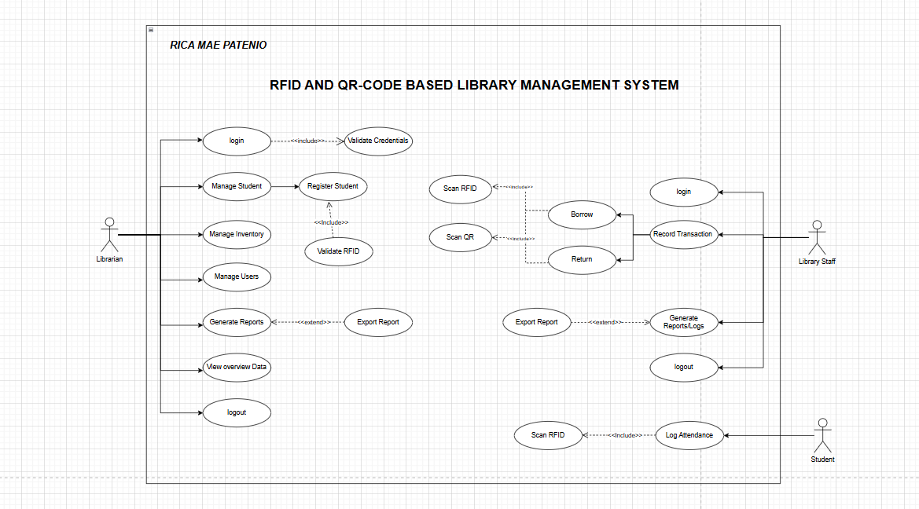
Cecilian Portal
Introduction
Literatures
Methodology
System Design
Evaluating & Testing
USE-CASE DIAGRAM

Slide 18
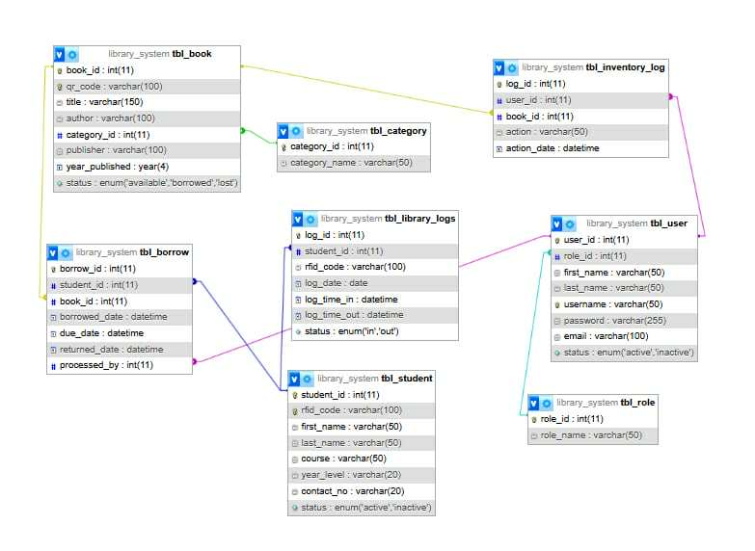
Cecilian Portal
Introduction
Literatures
Methodology
System Design
Evaluating & Testing
ENTITY-RELATIONSHIP DIAGRAM-(ERD)

Slide 19
Cecilian Portal
Introduction
Framework
Methodology
System Design
Evaluating & Testing
THANK YOU

